Slide 1
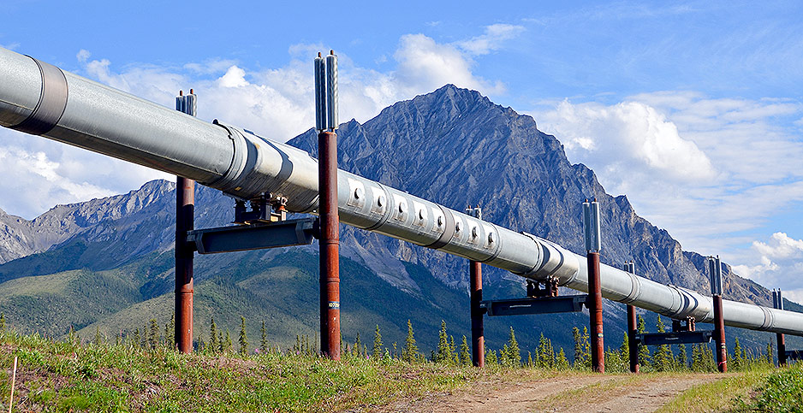

Slide 2
My Background
Started in IT in 1980
Started working with OT systems in 1998
Drilling, downhole, pipelines, refining and retail of petroleum products
Supported manufacturing systems
Support for Foothills Hospital ICU ward

Slide 3
What I will cover
Similarities and difference – big picture
Similarities and differences – DFIR
What to ask
Aligning with Processes
Tools
Communicating with Field Staff

Slide 4
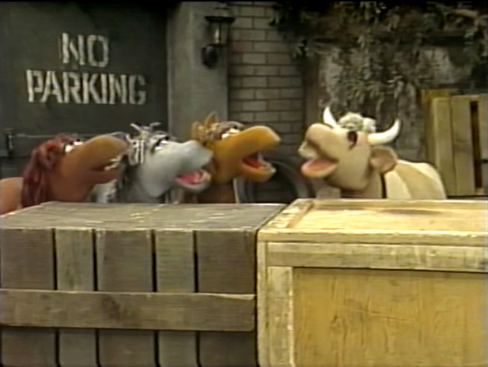
Pipeline IR
ICS is different!
No it’s not!

Slide 5
Different
Uptime and safety
Physical interaction
Blue team practices are new
“Pre-cyber security” designs
Less known protocols
And when things go wrong…
Notes:
Uptime and safety
These systems interact with the physical world.
Standard blue team practices such as logging are still relatively new and not widely implemented
A lot of the systems were designed before security was a consideration. Companies have been relying on physical security and air gaps. They are also fooling themselves on how well their air gaps work.
Less known protocols
And when things go wrong…

Slide 6
They go really wrong!

Slide 7
The Same
Limited number of breach scenarios
Computers are still computers.
Code is still code.
Standards
Time is money
Notes:
Limited number of breach scenarios
Computers are still computers.
Code is still code.
Networks may be old standards, but they are based on standards.
Time is money – just how much

Slide 8
One Small Refinery
$368.00 per minute
$22,080.00 per hour
$529,920.00 per day

Slide 9
What to ask Before you arrive
What appears to have happened?
What systems do you have?
Do you have a firewall?
Do you have any logging?
Notes:
What appears to have happened?
What systems do you have?
DCS or SCADA?
Make, model and versions of HMIs and Historians
Makes and models of PLCs and RTUs
Do you have a firewall?
Do you have any logging?

Slide 10
What to say when you get there
Safety orientation
Expect PPE
“Show me / Tell me about it.”

Slide 11
Processes
Identification
Collection
Preservation
Analysis
Reporting

Slide 12
Processes 2
Interviewing
Chain of custody

Slide 13
OT Processes
Event reconstruction
Config files

Slide 14
Tools
Logs
Historian - HMI
OS - Network
PLCs - RTUs
Notes:
Historian – Yes!
OS – Maybe.
Network – Maybe…
PLCs – No.
RTUs – depends, but probably.

Slide 15
Acquisition tools
Disk duplicators
Memory acquisition
Network based acquisition tool
JTAG equipment
Notes:
Disk duplicators– yes
Memory acquisition – yes
Network based acquisition tools - maybe
JTAG equipment – don’t bother
All are dependent on not interrupting operations!

Slide 16
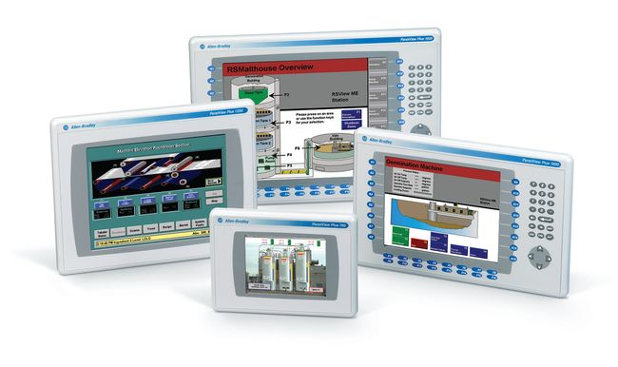
Some of the Gear
Field HMIs

Slide 17
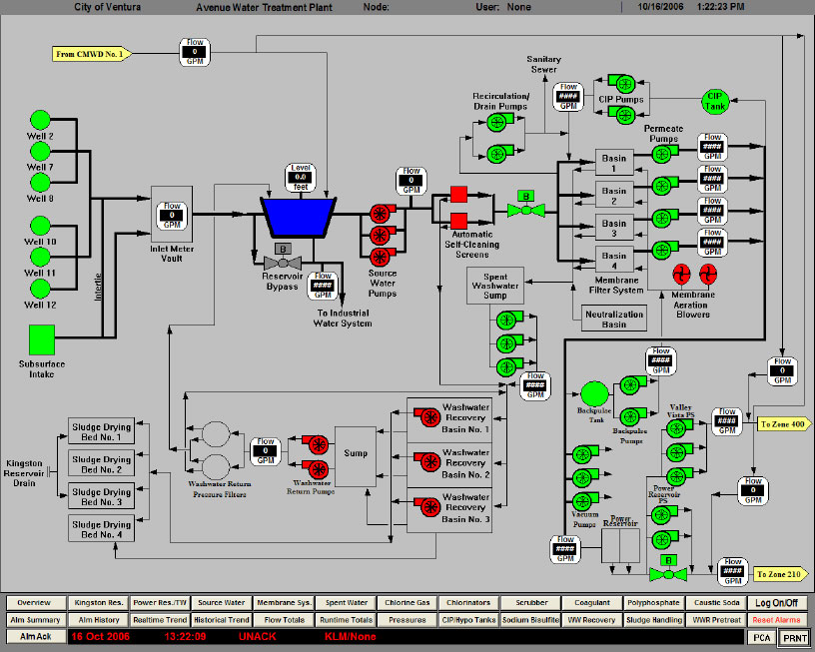
Gear II
Operator HMI screen

Slide 18
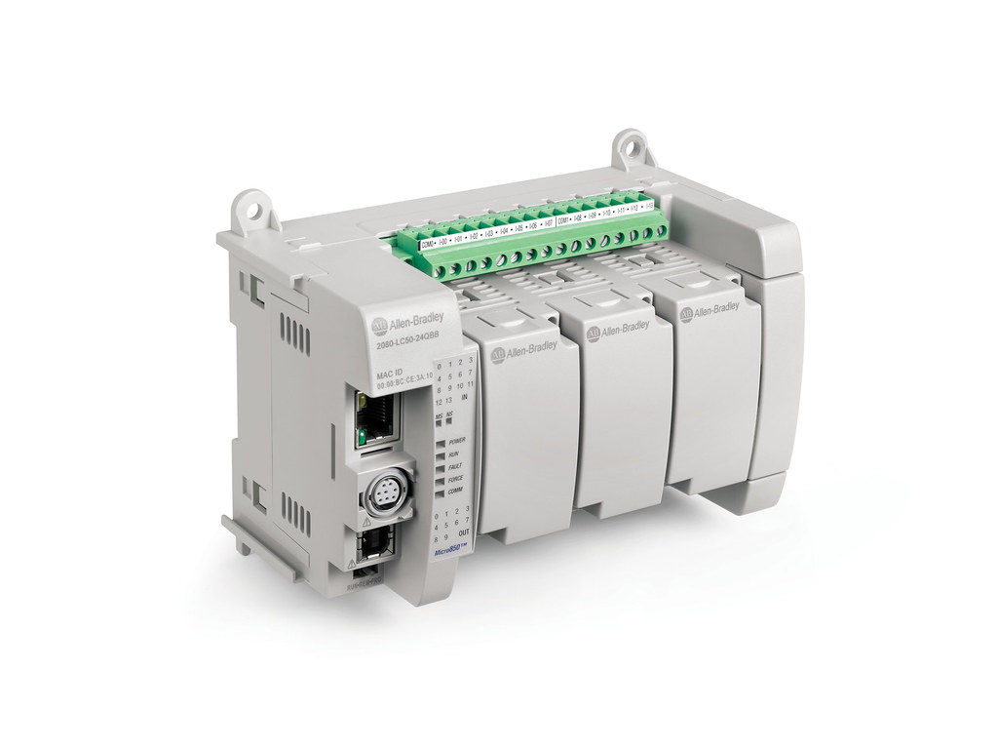
Gear – III
AB 505C / Rockwell 1700 series

Slide 19
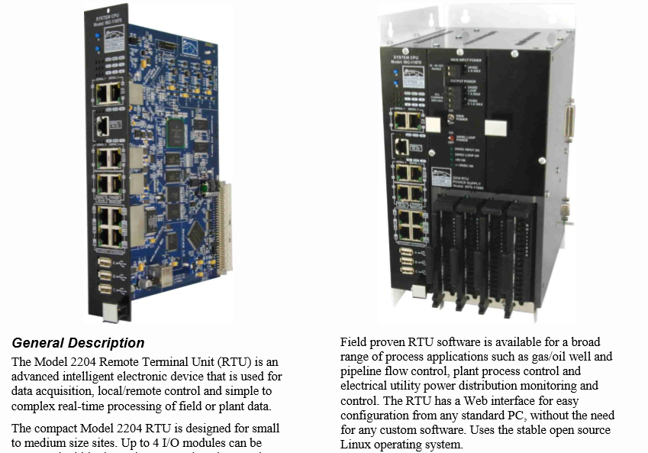
Gear IV
Riverbead Flow Meter

Slide 20
Talking to Field Staff
They are people, too
Proud of their site
Willing to share
Expect them to question you.
Notes:
They are people, too
Generally proud of their site
Are willing to share if you show that you are willing to listen
Expect them to question you.

Slide 21
Real Examples
Rogue 3rd party
German Steel factory

Slide 22
Questions?
smokydbear.ca
smokydbear@gmail.com

Slide 23
Special Thanks
David Cowen
Eric, Keith, Robert and Matt E.

